Slide 1
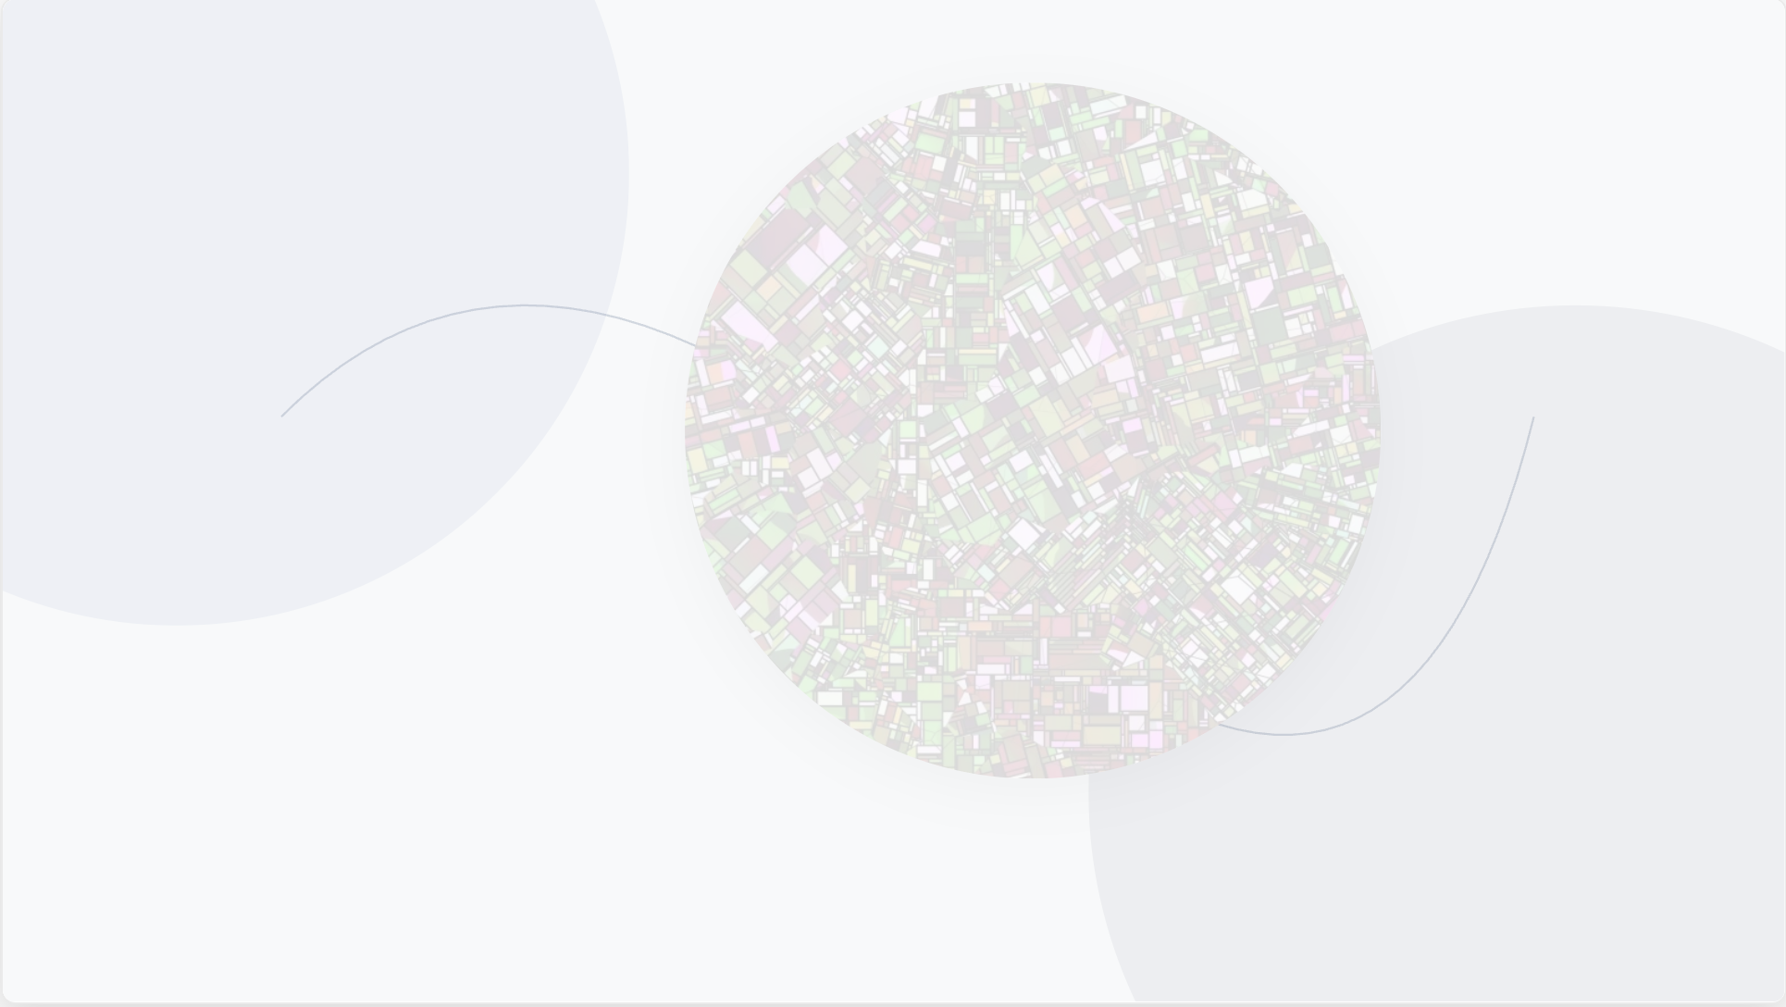
HerWay
Interpreting how public spaces feel
-------
SoReMo Fellowship Program

Slide 2
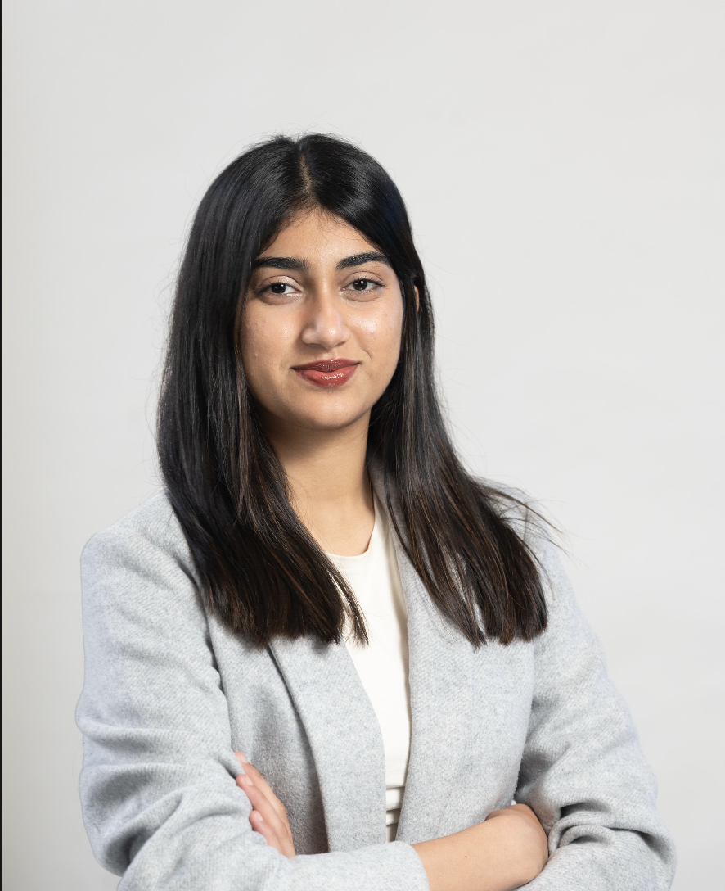
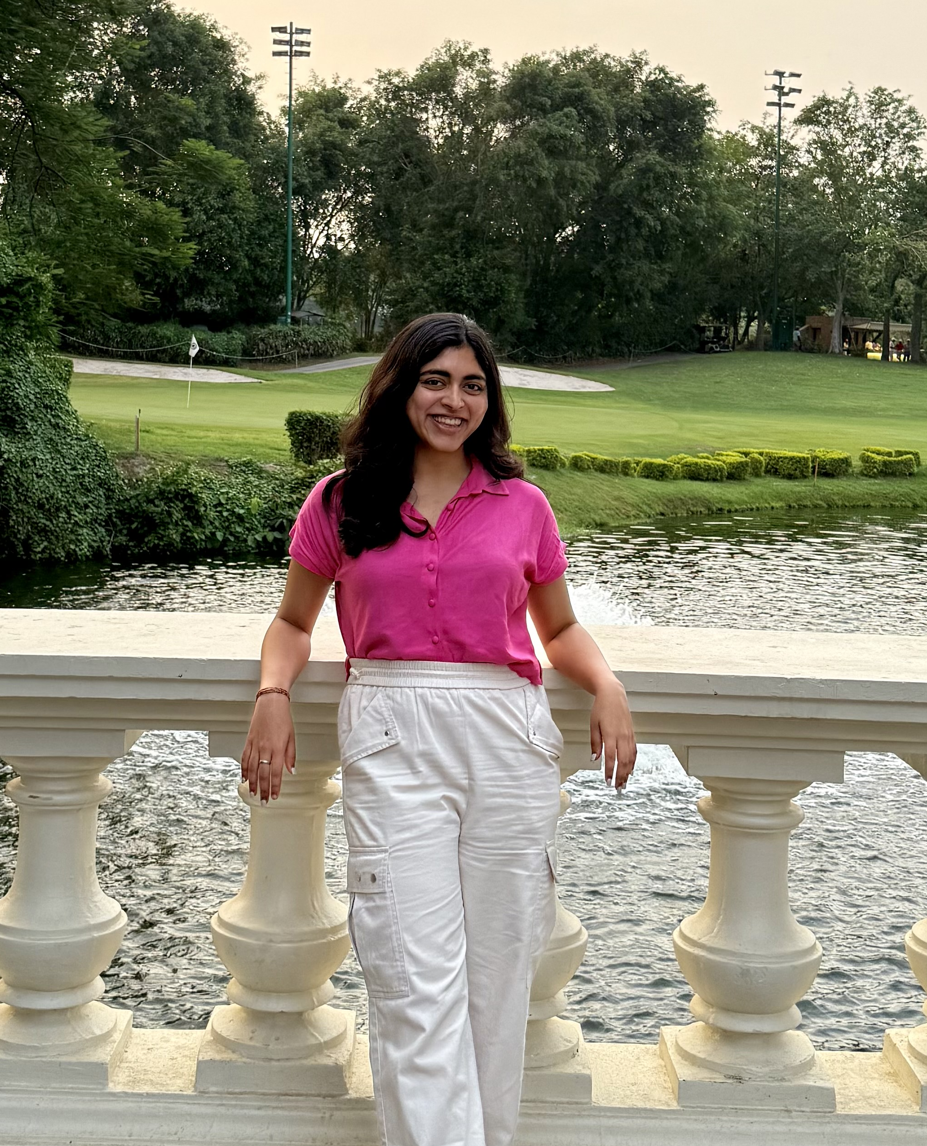
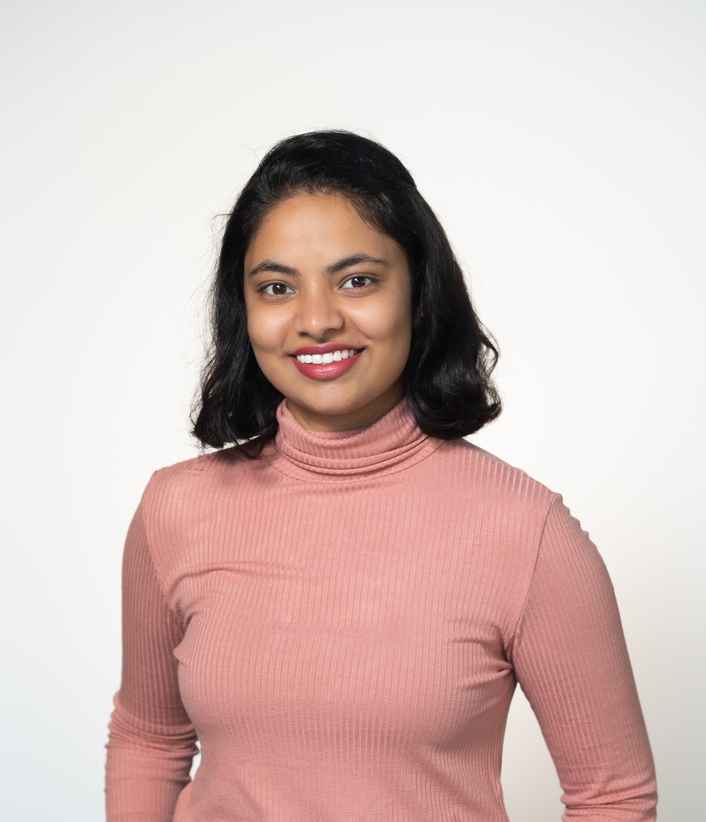
Thinking Machines
Sanjana Waghray
Sharanya Mishra
Gayathri Ananya
MAS in Data Science
MAS in Data Science
MAS in Data Science

Slide 3


Slide 4
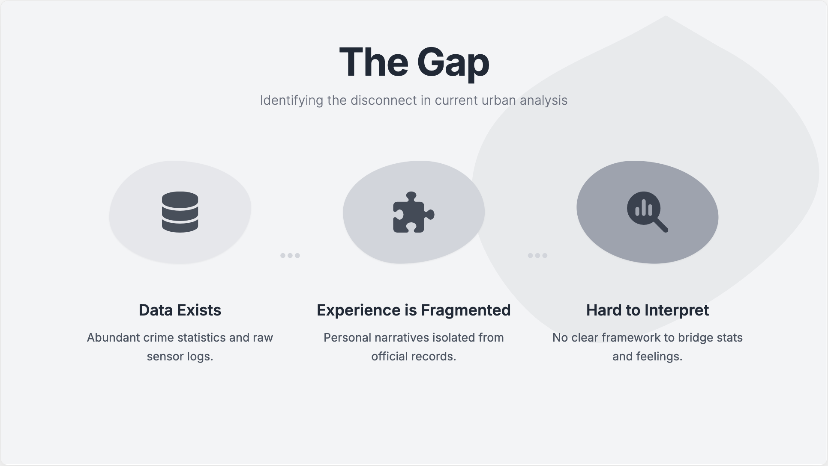

Slide 5
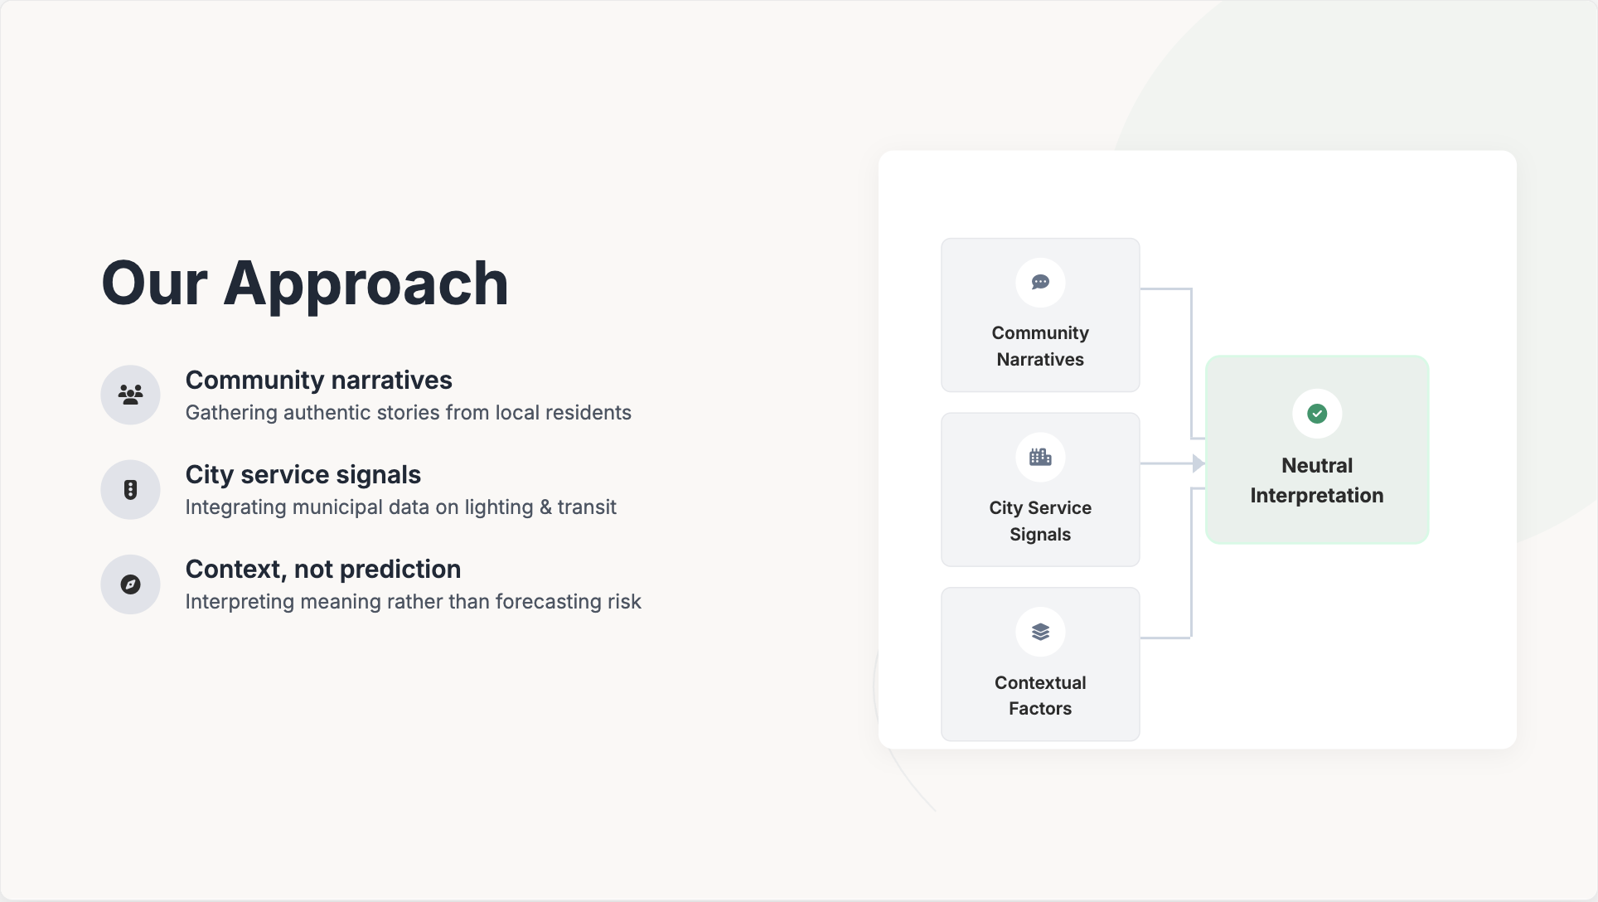

Slide 6
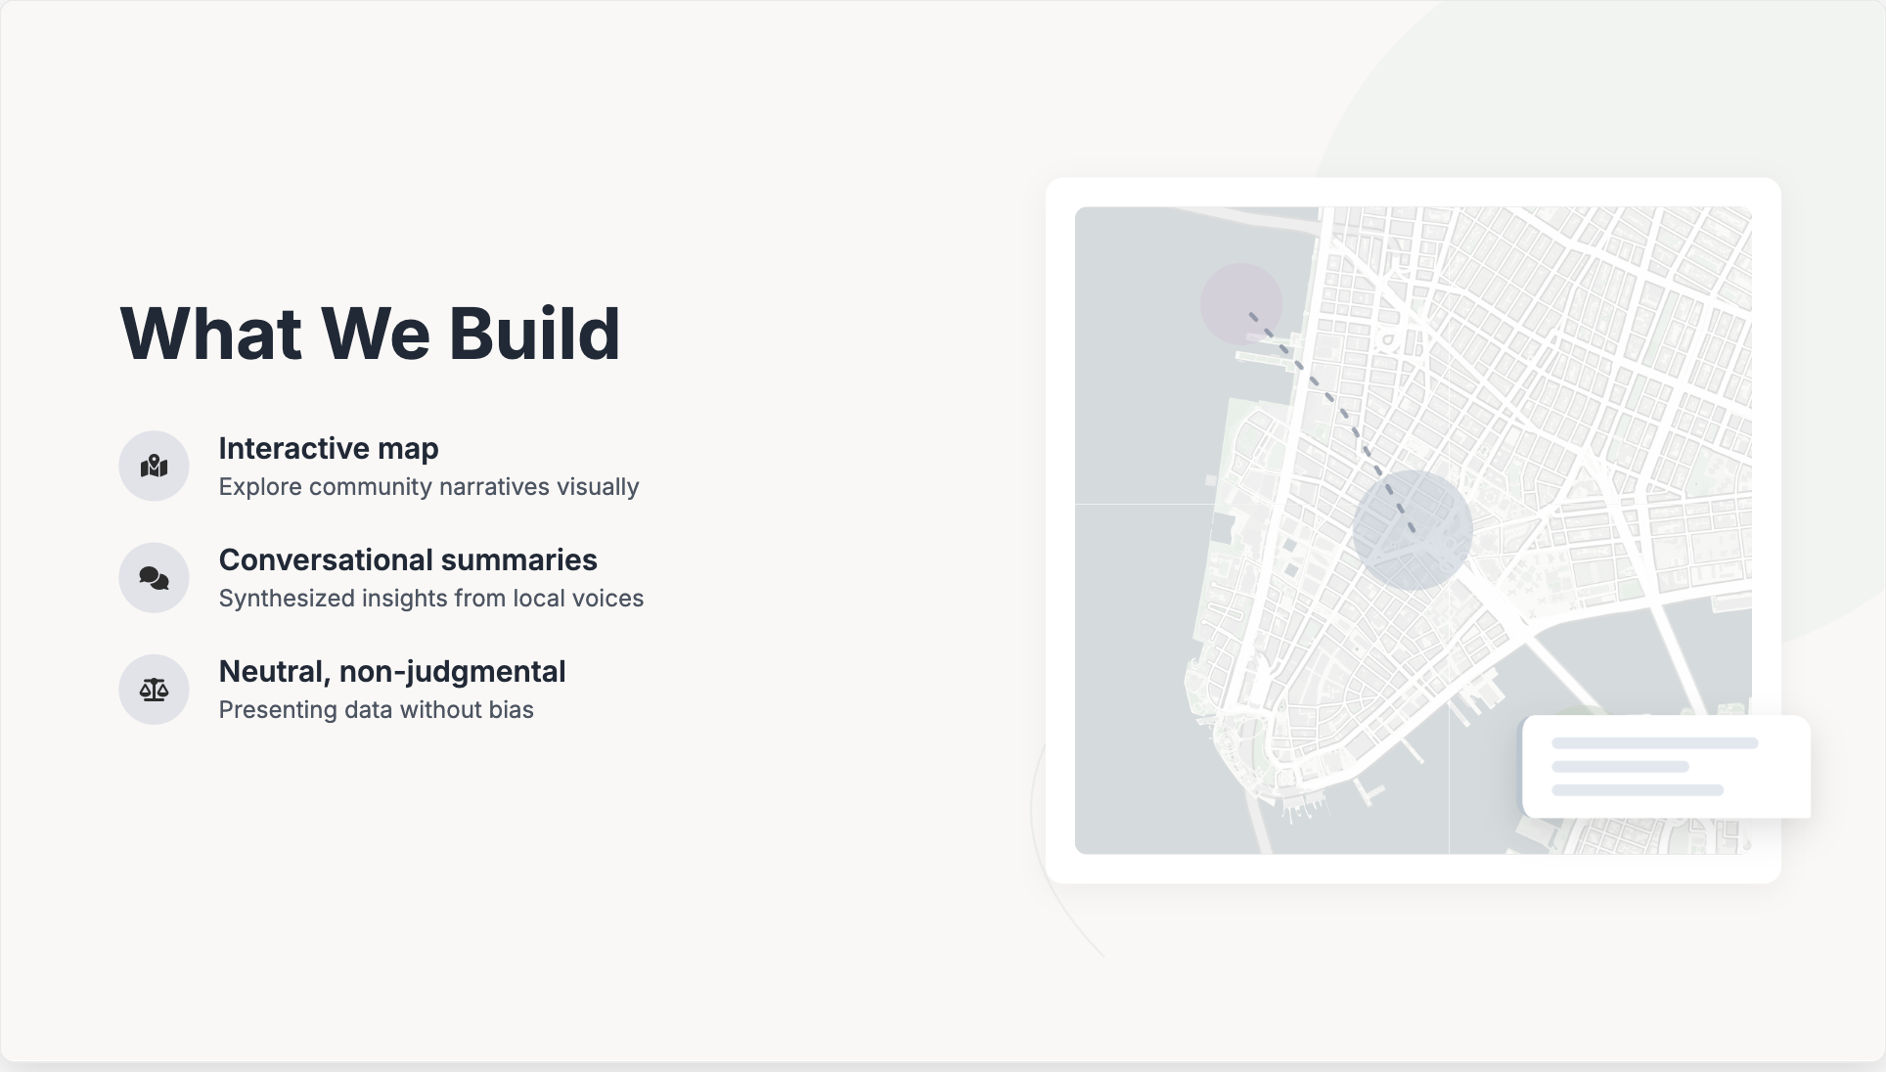

Slide 7
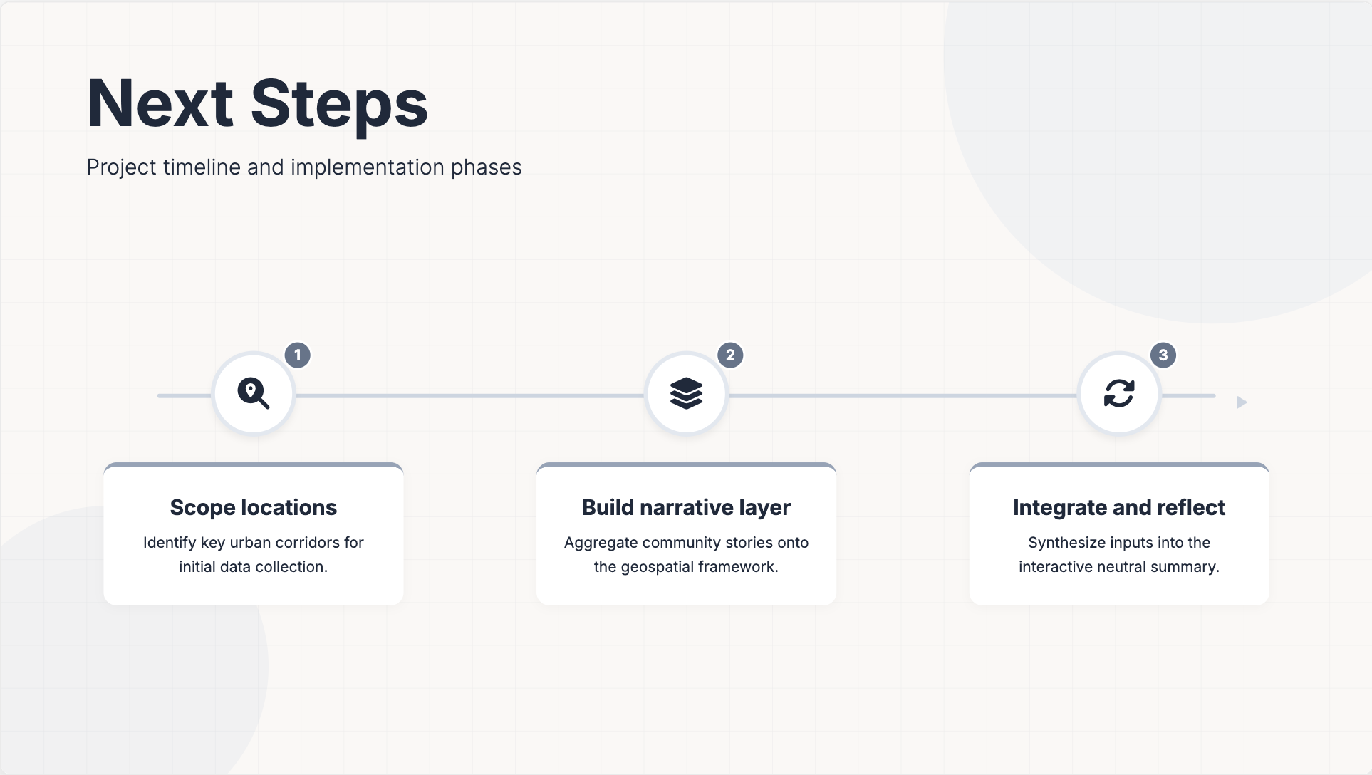

Slide 8
Thank you!

